Slide 1

CONCEPT OF HEALTH AND DISEASE - II

Slide 2
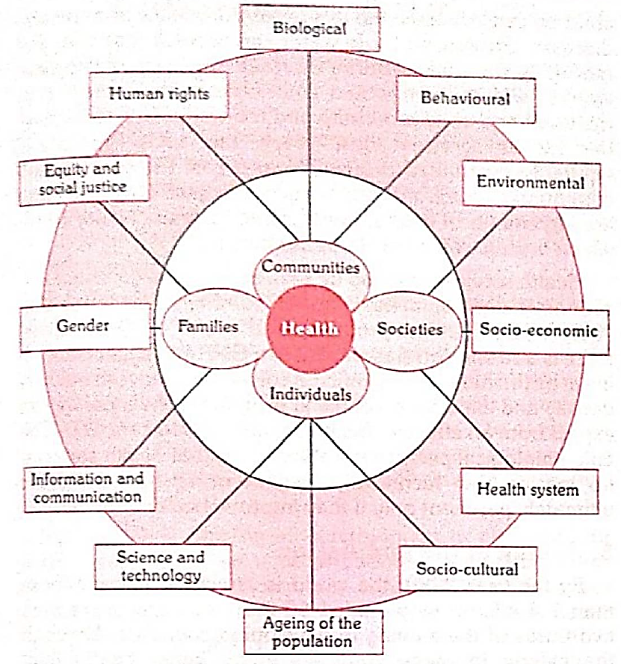

Slide 3
BIOLOGICAL DETERMINANTS
The physical & mental traits of every human being are determined by the nature of his genes at the moment of conception.
The genetic makeup is unique in the sense it cannot be altered after conception.
A number of diseases are now known to be of genetic origin, E.g., Chromosomal anomalies, errors of metabolism, mental retardation.
Medical genetics offers hope for prevention & treatment of a wide spectrum of diseases, thus the prospect of better medicine & longer & healthier life.
A positive health advocated by WHO implies that a person should be able to express as completely as possible the potentialities of his genetic heritage.

Slide 4
BEHAVIOURAL & SOCIO CULTURAL CONDITIONS
Life style denotes “ the way that people live”, reflecting a whole range of social values, attitudes & activities.
It is composed of cultural & behavioural patterns & life long personal habits (Alcoholism, smoking)that have developed through the process of socialization.

Slide 5
BEHAVIOUR & LIFE STYLE
Life styles are learnt through social interaction with parents & peer groups, friends, siblings & through school & mass media.
Many current health problems such as coronary heart disease, obesity, lung cancer, drug addiction are associated with life style.

Slide 6
LIFE STYLE ISSUES
In countries like India risk of illness & death are connected with lack of sanitation, poor nutrition, personal hygiene, elementary human habits, customs & cultural patterns.

Slide 7
ENVIRONMENT
It was Hippocrates who first related disease to environment, climate, water, & air.
Later Pettenkoffer in Germany revived the concept of disease – environment association.
Environment is classified as “internal” & “external”.
Internal environment of a man pertains to each & every component part, every tissue organ & organ system & their harmonious functioning within the system.
External or macro environment consists of those things to which man is exposed after conception.

Slide 8
It is defined as “all that which is external to the individual human host”.
It can be divided into physical, biological & psychosocial components , any or all of which affect can affect the health of man & his susceptibility to illness.
Some epidemiologists use the term “micro environment” or domestic environment or personal environment which reflects a person’s way of living & lifestyle. E.g., eating habits, personal habits.
The other environment includes occupational environment, socio economic environment, moral environment.

Slide 9
SOCIO ECONOMIC CONDITIONS
The health of a person is primarily dependent upon the level of socio economic development.
E.g., Per Capita income, GNP, education, nutrition, employment, housing & political system of the country.

Slide 10
ECONOMIC STATUS
The per capita GNP is the most widely accepted measure of general economic performance.
The economic progress of many countries has been a major factor in reducing the morbidity, mortality, increase in life expectancy & improving of the quality of life, family size, & the pattern of disease & deviant behaviour in the community.

Slide 11
EDUCATION
Education is the second major influencing factor in affecting the health of the population.
The world map of illiteracy closely coincides with the maps of poverty, malnutrition, ill health, high infant & child mortality rates.
Studies indicate that education to some extent compensates the effects of poverty on health, irrespective of the availability of health facilities.

Slide 12
OCCUPATION
Un employment usually shows a higher incidence of ill health & death.
For many, loss of work may mean loss of income & status.
It can cause psychological & social damage.
The very state of being employed in productive work promotes health.

Slide 13
POLITICAL SYSTEM
Health is closely related to the political system of a country. • Often the main obstacles to the implementation of health technologies are not technical rather political.
• 30. • Decisions concerning resource allocation, man power policy, choice of technology & the degree to which health services are made available & accessible to different segments of the society are examples of the manner in which the political system can shape community health services.
• 31. • The percentage of GNP spent on health is About 3%

Slide 14
HEALTH SERVICES
Health services are seen as essential for social & economic development. There is a strong correlation between GNP & Expectation of life at birth & the overall health status of the given population.
Health &Family welfare services aim at improving the health condition of the population.
India being a signatory member , to realize Heath For All has chalked out strategies like the PHC, CHC, HWC, Sub centes & other peripheral infrastructure.

Slide 15
AGING OF THE POPULATION
More than two thirds of people aged 60 & over are living in the developing countries.
A major concern of rapid population aging is the increased prevalence of chronic disease & disabilities.
Therefore aging process needs a special attention.

Slide 16
GENDER
The 1990 have witnessed a increase concentration on women’s issues. In 1993 The Global Commission on women’s Health was established.
The Commission drew up an agenda for action on women’s health covering nutrition, reproductive health, the health consequences of violence, aging, life style related conditions & occupational environment.
Inclusion of women’s health issues is a major breakthrough in the developmental plans.

Slide 17
OTHER FACTORS
The revolution in information & Communication Technology offers tremendous opportunities in providing an easy & instant access to medical information once difficult to retrieve.
It contributes to the dissemination of information world wide, serving the needs of many physicians, health professionals, bio medical scientists & researchers, the mass media & the public.
Health is not the sole contributor to the health & wellbeing of population, the potential of inter sectoral contributions to the health of communities is increasingly recognized

Slide 18
ECOLOGY OF HEALTH
Ecology is defined as the science of mutual relationship between living organisms and their environment.
Human ecology is defined as the study of human groups as influenced by environmental factors, including social & behavioral factors.

Slide 19
The human eco-system includes, In addition to the natural environment, all the dimensions of the man made environment.
Physical
Chemical
Biological
Psychological
Culture and all its products.

Slide 20
By constantly altering his environment, or eco-system by such activities as urbanization,industrialization, deforestation, land reclamation, construction of irrigation canals and dams. Man has created for himself new health problems.
Man's introduction into ecological cycles of disease has resulted in zoonotic diseases such as rabies, yellow fever, monkeypox, lassa fever etc.

Slide 21
Prevention of disease through ecological or environmental manipulations or interventions is much safer cheaper and a more effective rational approach than all other means of control.
It is through environmental manipulations that diseases such as cholera and other diarrhoeal diseases, Typhoid, malaria and other vector borne diseases and hook warm diseahoowarmpould be brought under control or eliminated.

Slide 22
RIGHT TO HEALTH
With the establishment of WHO, for the first time, the right to health was recognize.
The WHO constitution affirms that "the enjoyment of the highest attainable standard of health is one of the fundamental right of every human being without distinction of race, religion, political belief, economic or social condition"

Slide 23
The International Covenant of Economic, Social and Cultural rights widely, considered as the central instrument of protection of the right to health recognizes, "the right to health of everyone to enjoyment of the highest attainable standard of physical and mental health".
It is important to note that the covenant gives both physical health and mental health equal consideration.

Slide 24
The steps to be taken to achieve the full realization of the right to health include those necessary for:
The provision for the reduction of stillbirth rate and infant mortality and for the healthy development of the child.
The improvement of all aspects of environmental and industrial hygiene.
The prevention, treatment and control of epidemic and endemic, occupational and other diseases.
The creation of conditions, which would ensure to all medical service and medical attention in the event of sickness.

Slide 25
The human right to healthcare means that hospitals, clinics, medicines and doctor services must be accessible, available,acceptable (non discrimination, physical accessibility, affordability, and information accessibility), And of good quality for everyone, on an equitable basis where and when needed.
The key principles are:
Universality
Equity
Accountability
Transparency
Participation.

Slide 26
RESPONSIBILITY OF HEALTH
Individual responsibility
Community responsibility
State responsibility
International responsibility

Slide 27
Self-care in health
Presently, the trend in health care is self-care. It is defined as health activities, including promotion, maintenance, treatment, care and health-related decision-making carried out by individuals and families.
It refers to those activities. Individuals undertake in promoting their own health, preventing their own health, limiting their own disease, restoring their own health.

Slide 28
COMMUNITY RESPONSIBILITY
The current trend is to deem "medicinalize"health and involve the community in a meaningful way. This implies a more active involvement of families and community in Health Matters, which is.
Planning
implementation
Utilization
Operation
Evaluation of health services.
The emphasis has shifted from health care for the people to health care by the people.

Slide 29
There are 3 ways in which a community can participate.
The community can provide in shape of facilities, manpower, logistics support and possibly funds.
The community can be actively involved in planning, management and evaluation.
An equal contribution that That people can make, is by joining in and using health services.

Slide 30
STATE RESPONSIBILITY
In all civilized societies, the state can assume responsibility for the health and welfare of its citizen. The Constitution of India provides that health is a state responsibility.

Slide 31
INTERNATIONAL RESPONSIBILITY
The health of mankind requires the cooperation of governments, the people,national and international organizations both within and outside the United Nations system in achieving our health goals.
This corporation covers the such subject as exchange of experts, provision of drugs and supplies, border meetings with regard to control of communicable diseases.

Slide 32
HEALTH AND DEVELOPMENT
Since health is an integral part of development, all sectors of society have an effect on health. In other words, health services are no longer considered merely as a complex of solely medical measures, but a subsystem of overall social economic system. I
n the final analysis, human health and well being our ultimate goal of development

Slide 33
INDICATORS OF HEALTH
As the name suggests, indicators are only an indication of the given situation or a reflection of the situation. In WHO's guidelines of health programme evaluation, they are defined as the variables which help to measure changes. Often, they are used particularly in these changes cannot be measured directly as, for example, health and nutritional status. If measured, sequentially over time, they can indicate, direction and speed of change and serve the compare different areas or groups of people at the same moment in time.

Slide 34
Ideal indicators should be,
Should be valid, i.e. they should actually measure what they are supposed to measure
Should be reliable and objective, i.e. the answer should be seen if measured by different people in similar circumstances.
Should be sensitive, i.e. they should be sensitive to changes in the situation concerned
Should be specific, i.e. they should reflect changes only in situation concerned
Should be feasible, i.e. they should have the ability to obtain the data needed.
Should be relevant, i.e. they should contribute to the understanding of phenomenon of interest.

Slide 35
Are understanding of health, therefore, cannot be in terms of a single indicator; it must be conceived in terms of a profile, employing many indicators which can be classified as:
Mortality indicators,
morbidity indicators,
disability rates,
nutritional status indicators,
health care delivery indicators,
utilization rates,
indicators of social and mental health,
environmental indicators,
social economic indicators,
health policy indicators,
indicators of quality of life,
and other indicators

Slide 36
Mortality indicators include:
Crude death rate
Expectation of life
Age specific death rate
Infant mortality rate
Child death rate
Under-5 proportionate mortality rate
Maternal mortality rate
Disease-specific mortality rate
Case fatality rate
Years of potential life lost

Slide 37
Morbidity indicators
Mortality indicators do not reveal the Burden of ill health in the community.
Therefore, more morbidity indicators are used to supplement mortality data, to describe the health status of a population morbidity, statistics have also their own drawback.
They tend to overlook a large number of conditions which are subclinical or inapparent. That is the hidden part of iceberg disease.

Slide 38
The following morbidity rates are used for assessing ill health in the community:
Incidents and prevalence
notification rates
attendance rate at outpatient departments, health centres etc
Admission, readmission and discharge rates
duration of stay in hospital
spells of sickness or absence from work or school

Slide 39
Disability rates
The disability rates are based on the premise or notion that health implies a full range of daily activities.
The commonly used disability rates fall into two group.
(a) Event-type indicators
Number of days of restricted activity
Bed disability days
Work-loss days within a specified period

Slide 40
(b) Person-type indicators
Limitations of mobility: For example, confined to bed, confined to the house, special aid in getting around either inside or outside the house.
Limitations of activity: For example, limitation to perform the basic activities of daily living.

Slide 41
Health adjusted life expectancy: The name of the indicator use to measure healthy life expectancy, has been changed from Disability Adjusted life expectancy to health adjusted life expectancy.
It is based on life expectancy at birth, but includes an adjustment for time spent in poor health.
Quality adjusted life years: It is a measure of disease burden including both the quality and quantity of life lived. It is used in assessing the value of money of the medical intervention.
It is based on the number of years. Of life that would be added by intervention.

Slide 42
Disability free life expectancy: It is the average number of years. An individual is expected to live free from disability if current pattern of mortality and disability continue to apply.
Disability adjusted life years: It is the measure of overall disease Burden expressed as a number of years. Lost due to ill health disability or early death. It captures the population impact of important fatal and non-fatal disabling conditions through a single measure. The measure major used as disability adjusted life years which combines:
Years of lost life
Years lost to disability

Slide 43
Nutritional status indicators
Nutritional status is a positive health indicator. Three nutritional status indicators are considered important as indicators of health status, they are:
Anthropometric measurements of preschool children, e.g. weight and height, mid arm circumference.
Height and weight of children at School entry.
Prevalence of low birth weight, less than 2.5 kg.

Slide 44
Health care delivery indicators
Doctor-population ratio
doctor-nurse ratio
population-bed ratio
population per health/subcentre
Population per trained birth attendant

Slide 45
Utilization rates
Utilization of services or actual coverage is expressed as the proportion of people in need of a service who actually receive it in a given periodoftime, usually in year.
It is argued that utilization rates give some indication of the care needed by the population and therefore the health status of the population.

Slide 46
A few examples of utilization rates are cited below:
Proportion of infants who are "fully immunized" against nine EPI diseases.
Proportion of pregnant women who received antenatal care, or have their deliveries supervised by trained birth attendant.
Percentage of population using the various methods of family planning.
Bed occupancy rate
Average length of state in hospitals
Bed turnover ratio.

Slide 47
Indicators of social and mental health
As long as valid positive indicators of social and mental health are scarce, it is necessary to use indirect measures, viz. indicators of social and mental pathology.
These include suicide homicide, other acts of violence and other crime road. Traffic accidents, juvenile delinquency, alcohol and drug abuse, smoking consumption of tranquilizers, obesity, etc.
To these may be added family violence,battered wife and battered baby syndromes, and neglected an abandoned youth in the neighbourhood.

Slide 48
Environmental indicators
Environmental indicators reflect the quality of physical and biological environment in which diseases occur and in which people live.
They include indicators relating to pollution of air and water radiation, solid wastes, noise,exposure to toxic substances in food and drinks.
Among these, the most useful indicators are those measuring the proportion of population having access to save water and sanitation facilities.

Slide 49
Socio-economic indicators.
These indicators do not directly measure health. They are of great importance in interpretation of indicators of health care these include:
Rate of population increase
per capita GNP
level of unemployment
Dependency ratio
literacy rates, especially female literacy rates,
family size
housing, the number of persons per room
per capita calorie availability

Slide 50
Health policy indicators
The single most important indicator of political commitment is a location of adequate resources. The relevant indicators are :
proportion of GNP spent on health services
proportion of GNP spent on health related activities, (including water supply, sanitation housing and nutrition community development)
and, proportion of total health resources devoted to primary health care.

Slide 51
Indicators of quality of life
Quality of life is difficult to define and even more difficult to measure. Various attempts have been made to reach one composite index from a number of health indicators.
The physical quality of life index is one such index. This consolidates three indicators:
infant mortality
life expectancy at age one
and, literacy.

Slide 52
Social indicators
Social indicators as defined by United Nations statistical office, Have been divided into twelve categories:
population
family formation,
families, and households,
learning and education services,
earning activities,
distribution of income consumption and accumulation,
social security and welfare services,
health services and nutrition,
housing and its environment,
public order and safety
time use
leisure and culture
social statification,
and mobility

Slide 53

Thank you

